Slide 1
Fieldbook: An open-source Android
app for collecting phenotypic data
Prasad Peteti

Slide 2
Fieldbook
Phenotypic data collection
Navigate between plots or traits
Extra plot information shown
Manage traits within the app
12 custom trait formats/layouts
Highly customizable
5900 + total installs

Slide 3

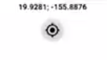

Fieldbook Traits
Numeric
Categorical
Percent
Date
Boolean
Photo
Text
Disease rating
Location
Counter
Multicat
Audio

Slide 4
How do I use Field Book ?
Design your field in Cassava Field Book
Export the layout file
Transfer file to phone/tablet
Import file into Field Book - local or cloud
Create or import traits
Collect data
Export data
Upload to Temporary storage or breedbase

Slide 5
Layout file (.xls or .csv)
plot_name | accession_name | plot_number | block_number | is_a_control | rep_number
UYT3-2_1_1_1_TZKBH12_521 | TZKBH12HS521 | 1 | 1 |  | 1
UYT3-2_1_1_2_TZKBH12_1032 | TZKBH12FS1032 | 2 | 1 |  | 1
UYT3-2_1_1_3_TZKBH12_898 | TZKBH12FS898 | 3 | 1 |  | 1
UYT3-2_1_1_4_TZKBH12_130 | TZKBH12HS130 | 4 | 1 |  | 1
UYT3-2_1_1_5_TZKBH12_833 | TZKBH12FS833 | 5 | 1 |  | 1
UYT3-2_1_1_6_TZKBH12_706 | TZKBH12HS706 | 6 | 1 |  | 1
UYT3-2_1_1_7_TZKBH12_311 | TZKBH12HS311 | 7 | 1 |  | 1
UYT3-2_1_1_8_TZKBH12_575 | TZKBH12HS575 | 8 | 1 |  | 1
UYT3-2_1_1_9_MKURANGA1 | MKURANGA1 | 9 | 1 | 1 | 1
UYT3-2_1_1_10_TZKBH12_576 | TZKBH12HS576 | 10 | 1 |  | 1
UYT3-2_1_1_11_TZKBH12_601 | TZKBH12HS601 | 11 | 1 |  | 1
UYT3-2_1_1_12_TZKBH12_332 | TZKBH12HS332 | 12 | 1 |  | 1
UYT3-2_1_1_13_TZKBH12_269 | TZKBH12HS269 | 13 | 1 |  | 1
UYT3-2_1_1_14_TZKBH12_100 | TZKBH12FS1000 | 14 | 1 |  | 1
UYT3-2_2_2_15_TZKBH12_321 | TZKBH12HS521 | 15 | 2 |  | 2
UYT3-2_2_2_16_TZKBH12_1000 | TZKBH12FS1000 | 16 | 2 |  | 2
UYT3-2_2_2_17_TZKBH12_269 | TZKBH12HS269 | 17 | 2 |  | 2
UYT3-2_2_2_18_TZKBH12_601 | TZKBH12HS601 | 18 | 2 |  | 2
UYT3-2_2_2_19_TZKBH12_311 | TZKBH12HS311 | 19 | 2 |  | 2
UYT3-2_2_2_20_TZKBH12_130 | TZKBH12HS130 | 20 | 2 |  | 2
UYT3-2_2_2_21_TZKBH12_1032 | TZKBH12FS1032 | 21 | 2 |  | 2
UYT3-2_2_2_22_MKURANGA1 | MKURANGA1 | 22 | 2 | 1 | 2
UYT3-2_2_2_23_TZKBH12_832 | TZKBH12FS833 | 23 | 2 |  | 2
UYT3-2_2_2_24_TZKBH12_575 | TZKBH12HS575 | 24 | 2 |  | 2
UYT3-2_2_2_25_TZKBH12_332 | TZKBH12HS332 | 25 | 2 |  | 2
UYT3-2_2_2_26_TZKBH12_706 | TZKBH12HS706 | 26 | 2 |  | 2
UYT3-2_2_2_27_TZKBH12_576 | TZKBH12HS576 | 27 | 2 |  | 2
UYT3-2_2_2_28_TZKBH12_898 | TZKBH12FS898 | 28 | 2 |  | 2

Slide 6
Trait file (.trt file)
Trait | format | defaultValue | min | max | details | categories | isVisible | realPosition
sprout count at one-month|CO_334:0000213 | numeric |  |  |  | sprout count at one-month |  | TRUE | 1
sprout count at three-month|CO_334:0000214 | numeric |  |  |  | sprout count at three-month |  | TRUE | 2
days to first female flower open on the third branch visual observation|CO_334:0000515 | numeric |  |  |  | days to first female flower open on the third branch visual observation |  | TRUE | 3
initial plant vigor assessment 1-5|CO_334:0000220 | categorical |  |  |  | initial plant vigor assessment 1-5 | 1/2/3/4/5 | TRUE | 4
plant height measurement in cm|CO_334:0000018 | numeric |  |  |  | Measured as height from ground level to the top of canopy at harvest |  | TRUE | 5
unexpanded apical leaf color visual rating 1-9|CO_334:0000101 | qualitative |  |  |  | Trait monitored by observing the color of unexpanded apical leaves | 3/5/7/9 | TRUE | 6
dry matter content by specific gravity method|CO_334:0000160 | numeric |  |  |  | dry matter content by specific gravity method |  | TRUE | 7
fresh fibrous root weight per plot|CO_334:0000328 | numeric |  |  |  | fresh fibrous root weight per plot |  | TRUE | 8
root number counting|CO_334:0000011 | numeric |  |  |  | Count the number of storage root tubers per plant at harvest. |  | TRUE | 9
dry matter content percentage|CO_334:0000092 | numeric | 50 | 0 | 100 | Measured root dry weight as percentage of 100g weight of the root tubers |  | TRUE | 10

Slide 7
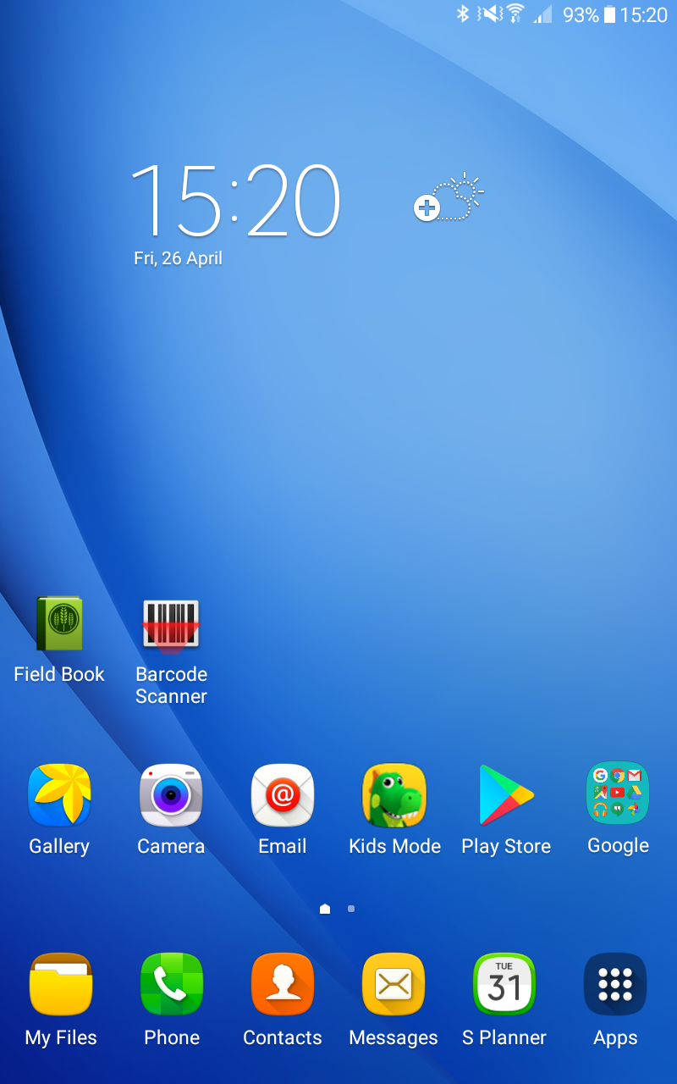
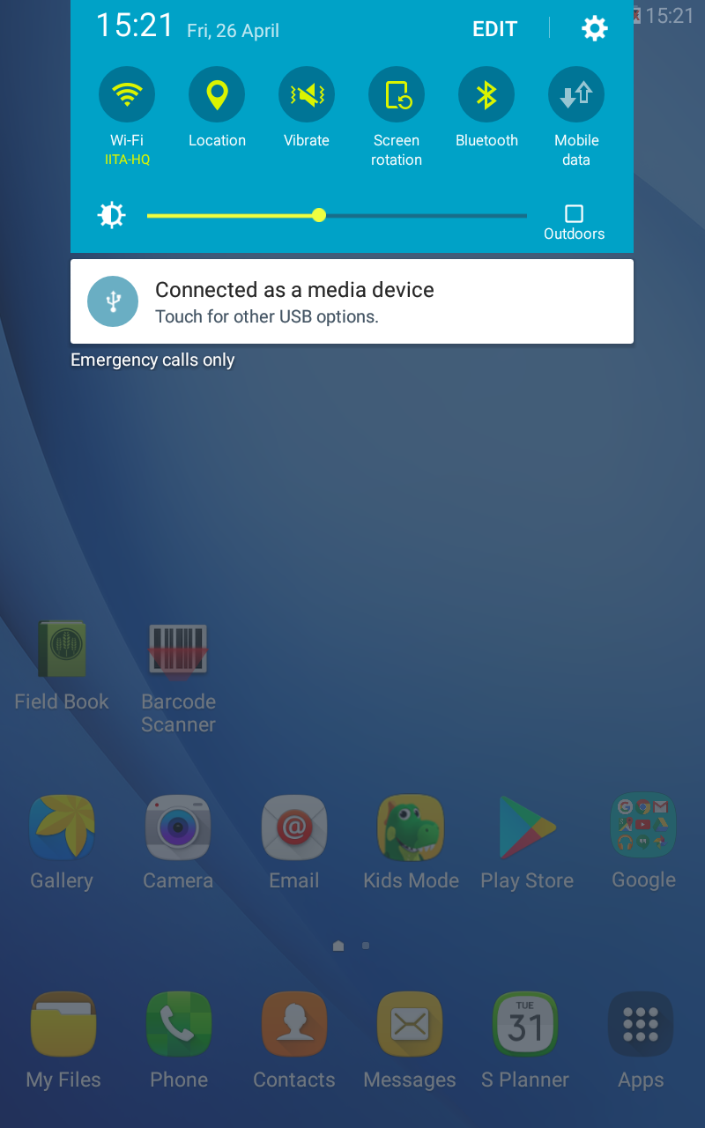
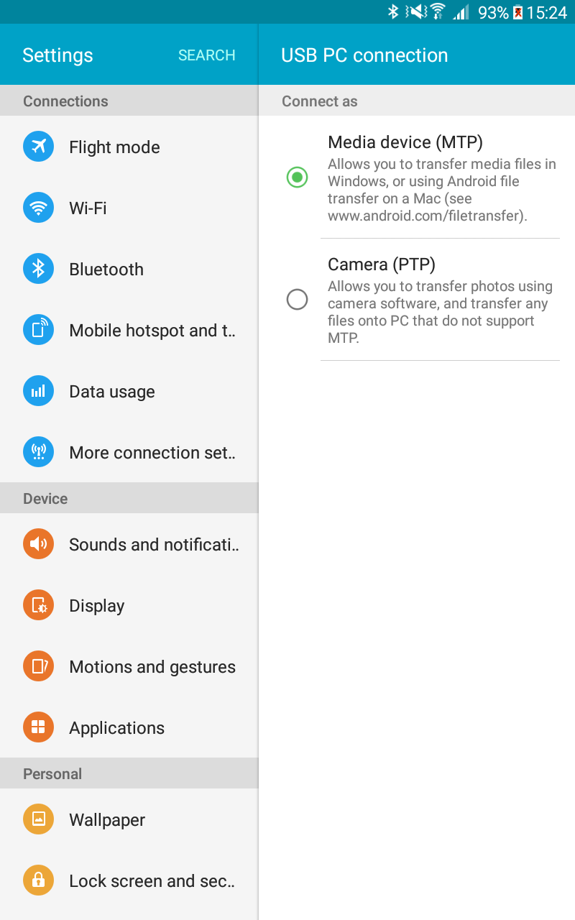
Transferring files

Slide 8
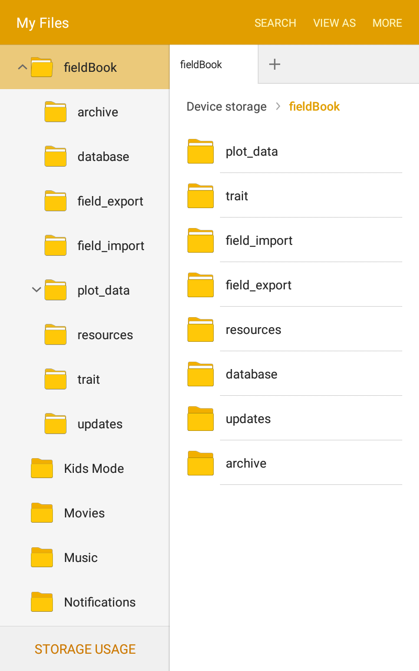
File storage
Once Field Book is installed and launched, it will create several folders in your device’s memory:
plot_data : audio and photo data associated with plots are organized and stored in this folded
trait : this folder contains backed up trait files and the disease rating custom scale
field_import : Field Book will look for files to import in this folder
field_export : exported files are stored in this folder
resources : this folder can hold pictures and files that are accessible from the main data collection screen
database : this folder contains the files that are exported from the database
updates : this folder contains updates information of the application
archive : this folder contains helpful output to debug different errors that may occur

Slide 9
Importing using Local Storage & Cloud Storage

Slide 10
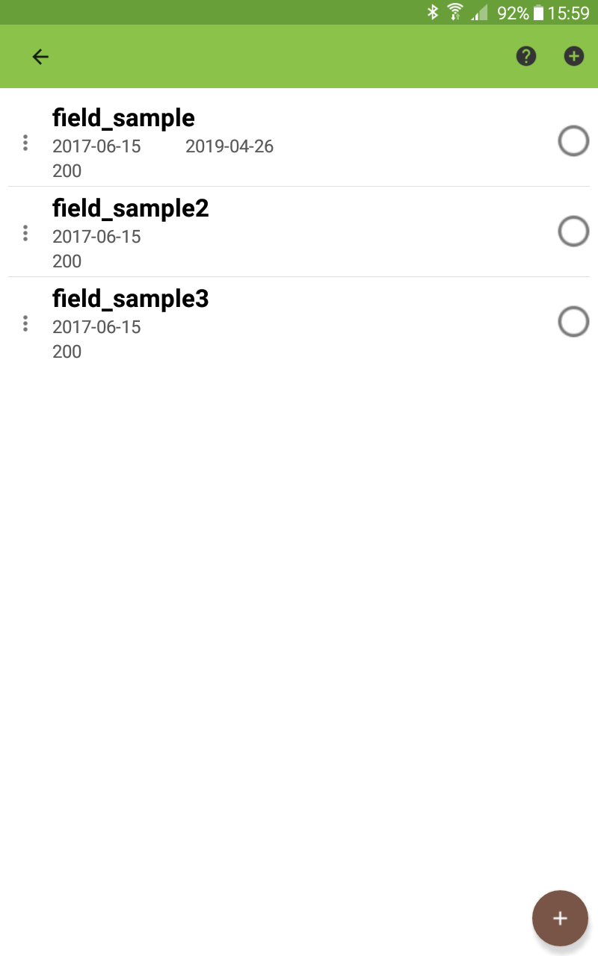
Managing Fields
Fields selectable from list
Import all of the fields you need for the season
Each row shows:
Date imported
Date edited
Date exported
Number of entries

Slide 11
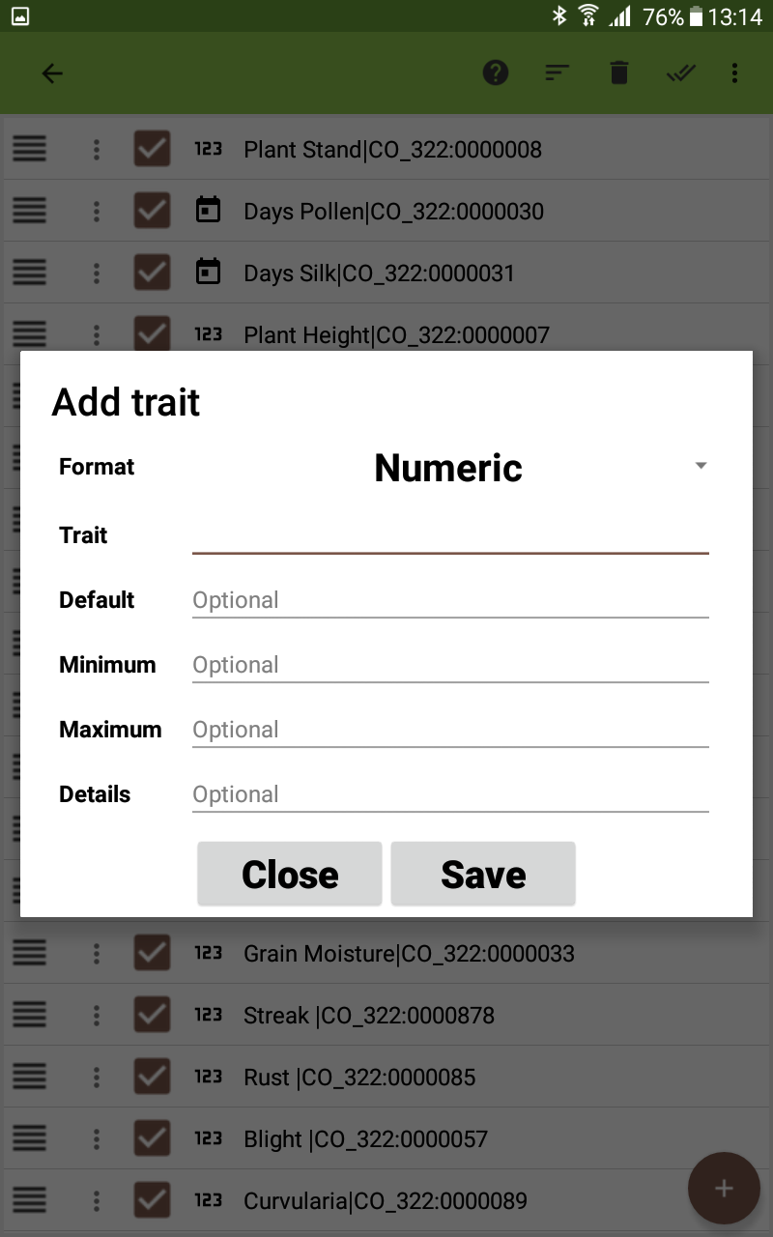
Creating Traits
Import/Export existing trait files
Use the + button to add a new trait
Choose the trait format
Enter in trait name and other info if required

Slide 12
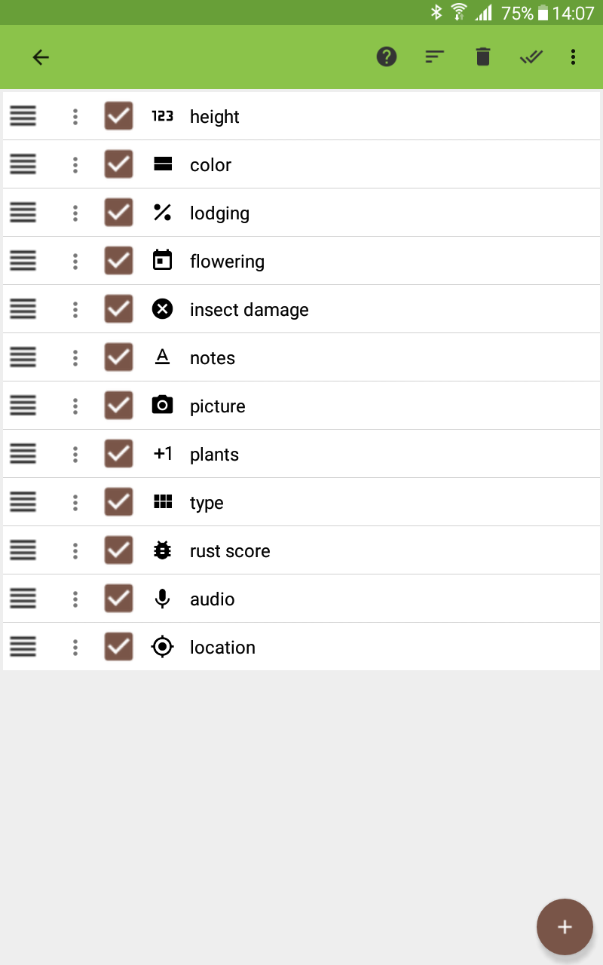
Managing Traits
Traits can be :
Reordered via drag and drop
Hidden from main screen by toggling checkbox
Copied, edited, deleted via each trait’s menu button
Sort traits by:
Name
Visibility
Format

Slide 13
Field Book

Slide 14
Field Book

Slide 15
Field Book

Slide 16
Field Book

Slide 17
Field Book

Slide 18
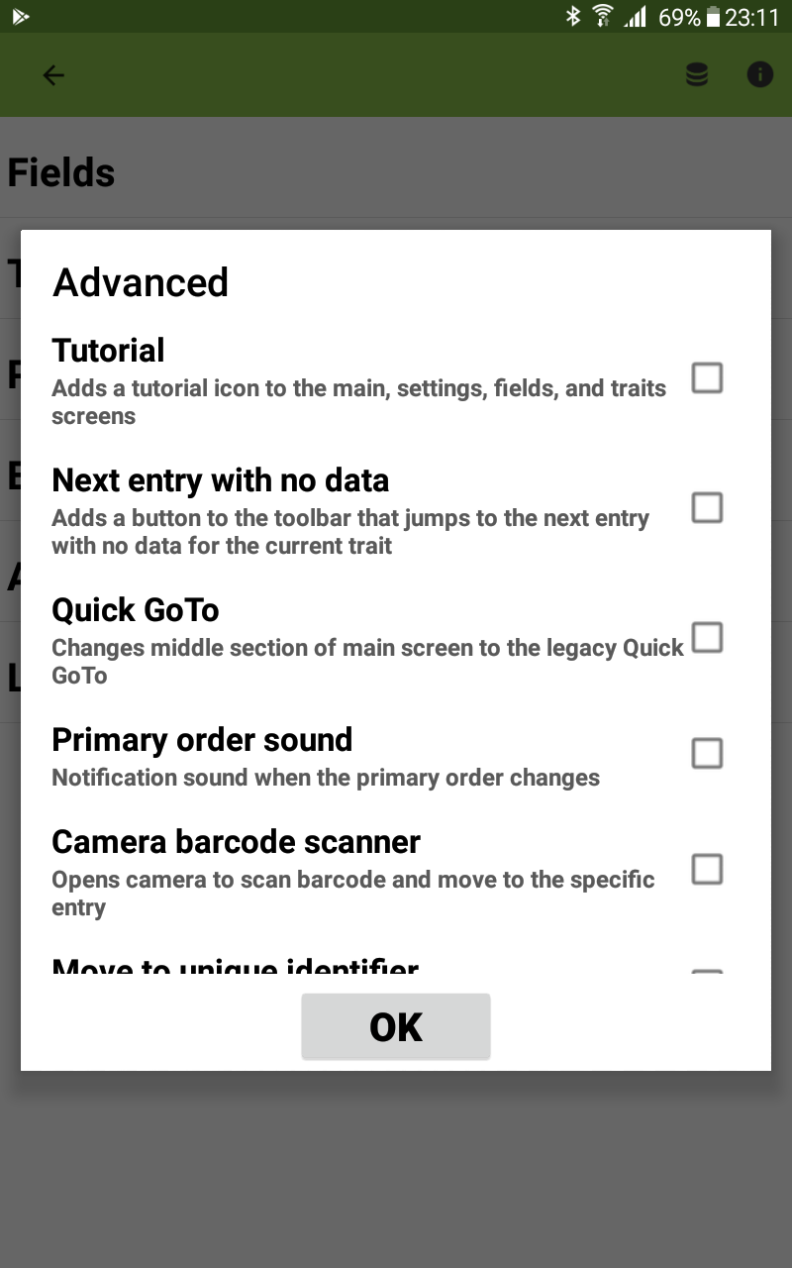
Advanced settings
Tutorial
Datagrid
Quick GoTo
Move to unique id (text or barcode)
Next entry without data
Primary order sound
Disable left/right entry arrow if no data
Cycling traits advances entry

Slide 19
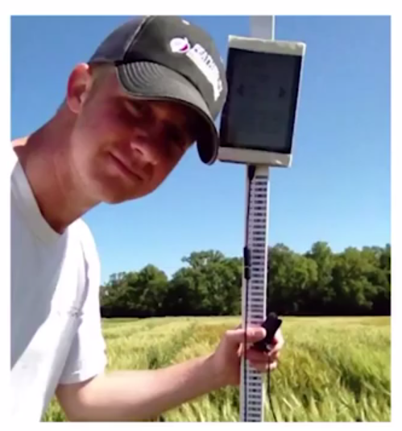
Barcodes
USB barcode scanners plug directly into tablet
Barcode text typed directly into text traits
Combine with tools to quickly collect phenotypes (e.g. height, leaf length)

Slide 20
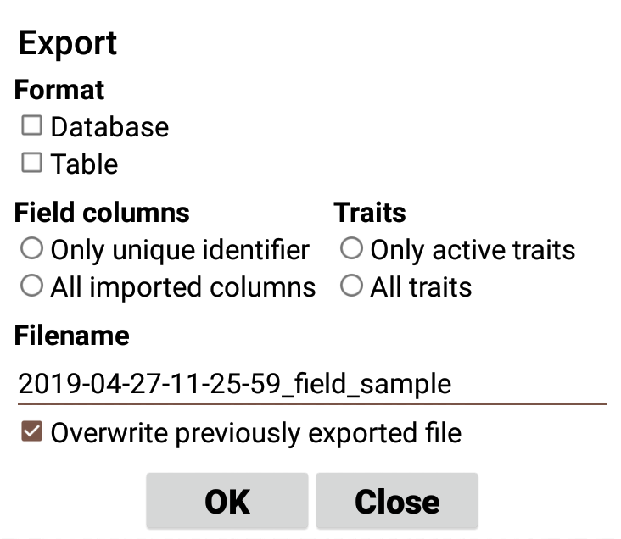
Exporting data
Exports to CSV
Two formats : database, table
Choose what gets exportd
All field columns vs. Unique ID
All traits vs. Active traits
Overwrite previous export
Send file option after export

Slide 21
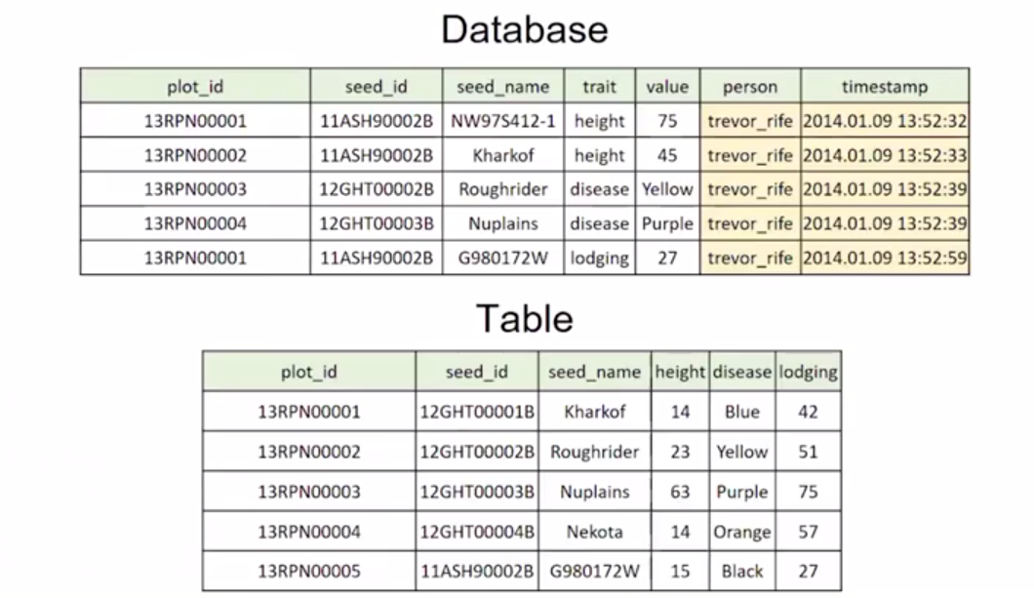
Exporting data

